Slide 1
War and Independence
Part 11
End of War

Slide 2
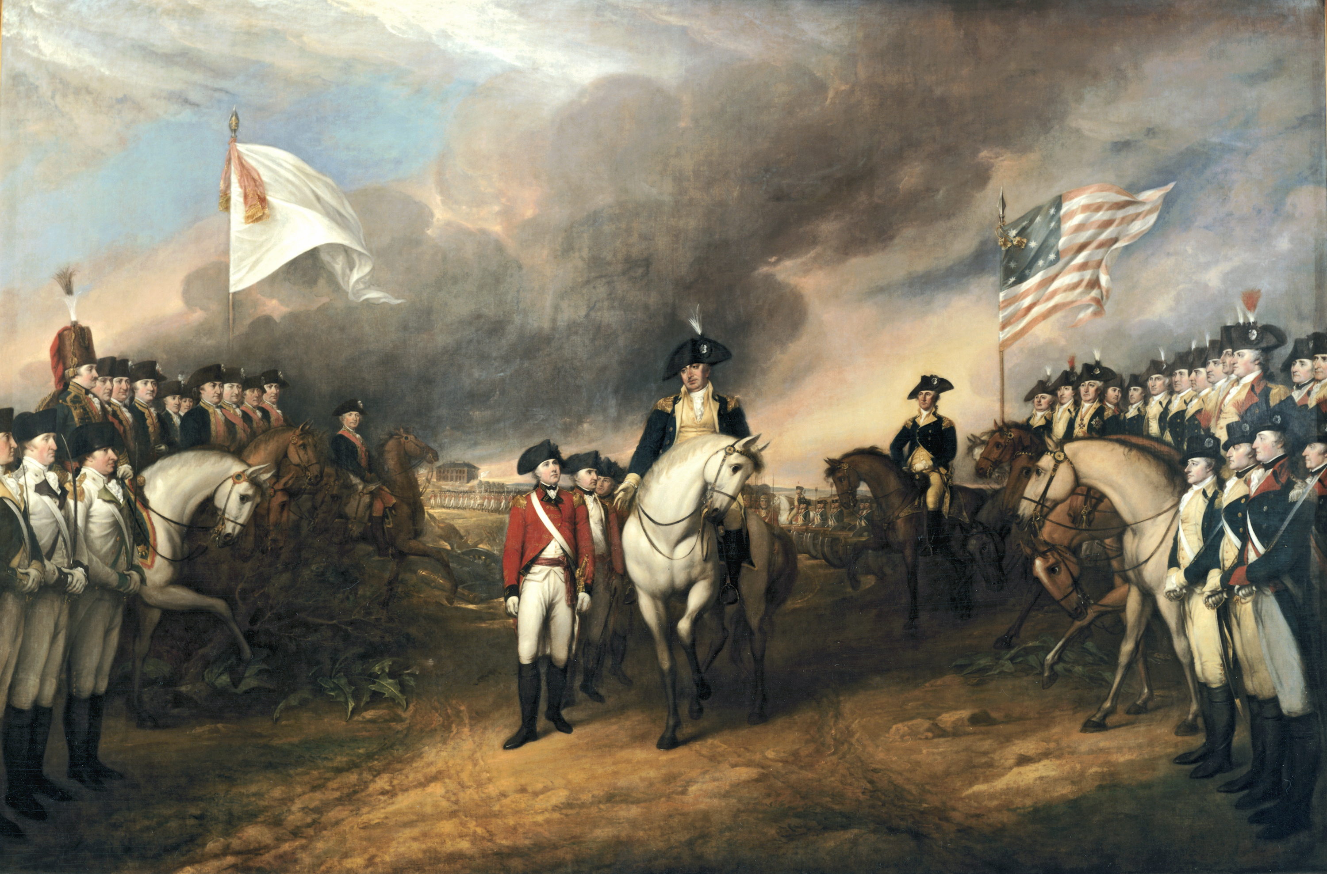
The surrender of the British forces at Yorktown in October of 1781 was the beginning of the end of the Revolutionary War.

Slide 3
Even though small battles, or skirmishes, would take place sporadically for the next two years, peace talks would take place between Americans and the British.

Slide 4
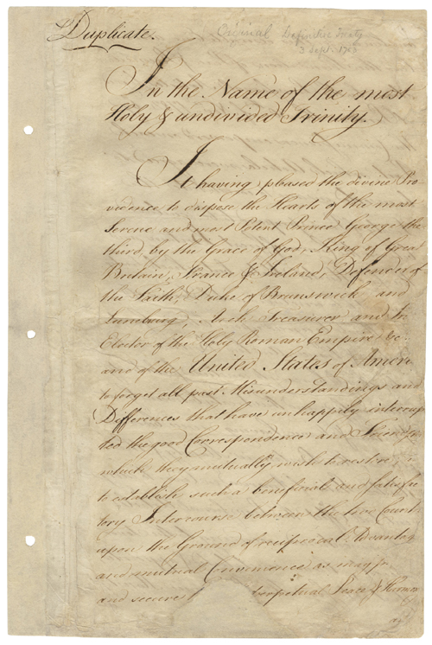
On September 3, 1783, the Treaty of Paris officially ended the Revolutionary War.

Slide 5
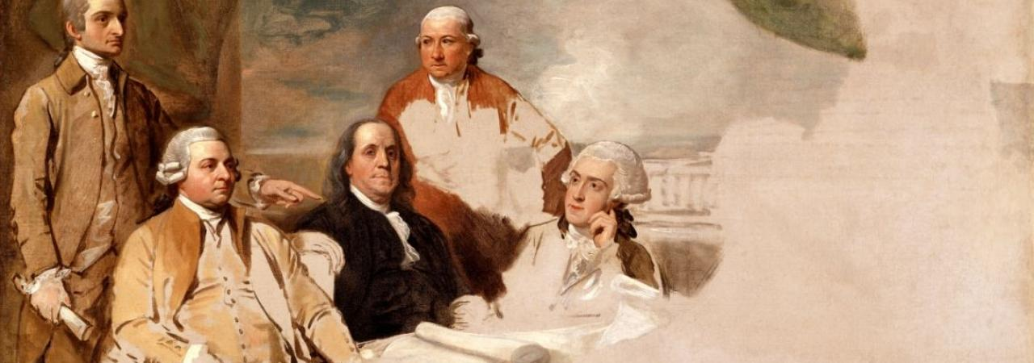
The American delegates who worked on the negotiations for the treaty were Ben Franklin, John Adams, and John Jay.

Slide 6
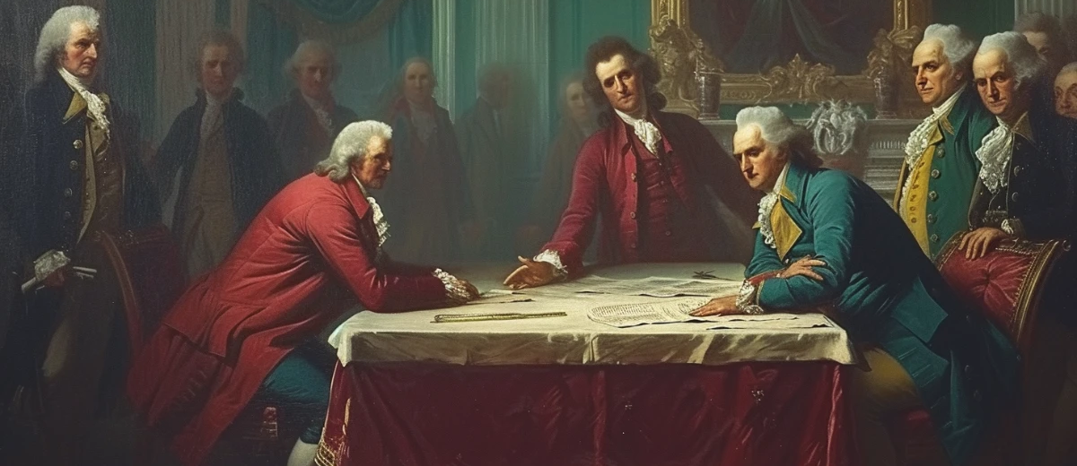
The Treaty of Paris did several things….

Slide 7
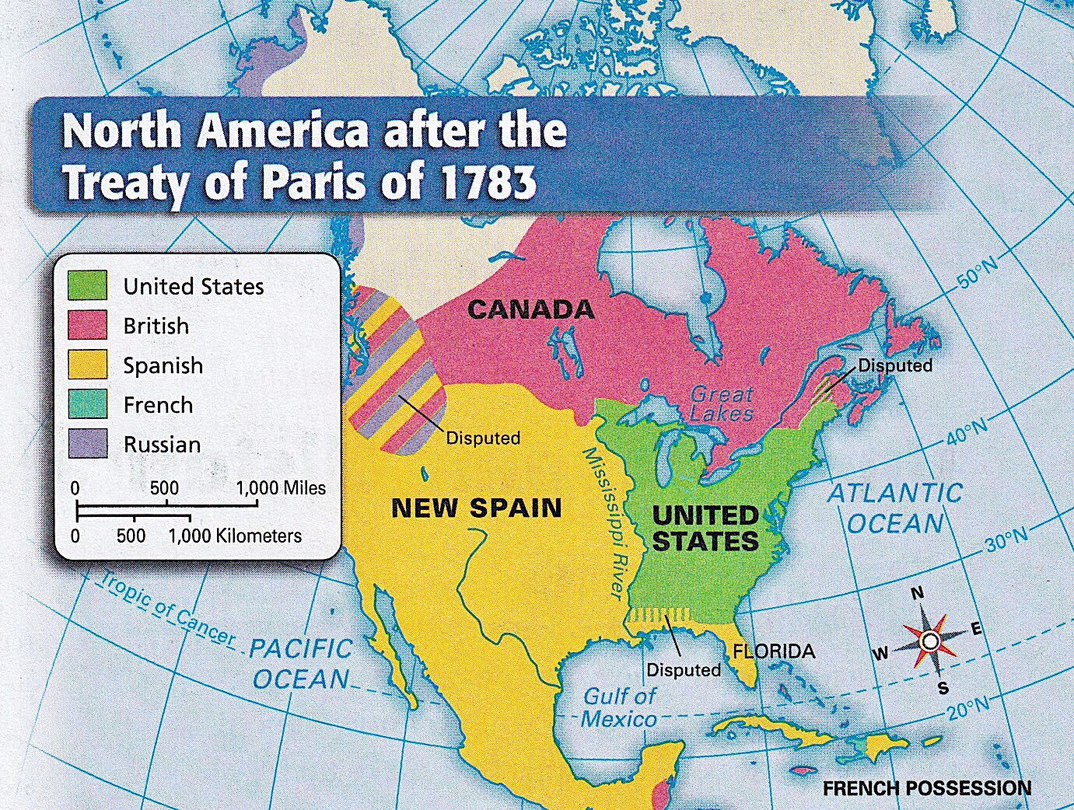
Britain recognized the United States as an independent nation.

Slide 8
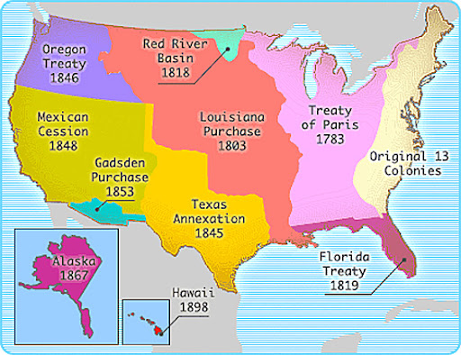
The treaty set the boundaries for the United States. It would extend from the Atlantic Ocean to the Mississippi River, and from Canada to Spanish Florida.

Slide 9
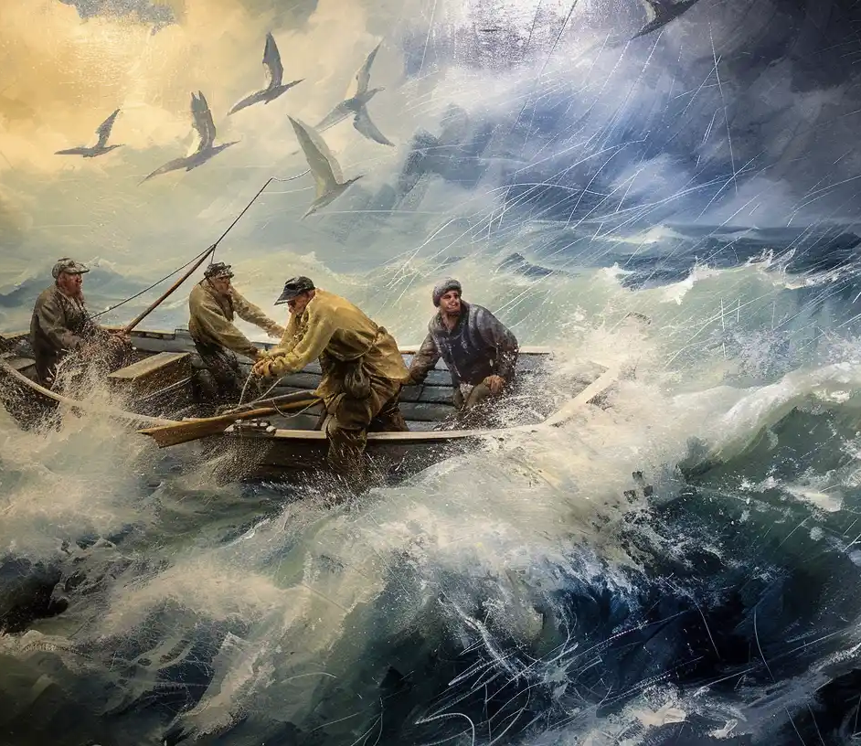
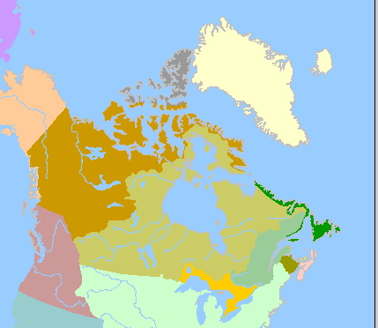
The U.S. would receive fishing rights off Canada’s Atlantic Coast, near Newfoundland and Nova Scotia.

Slide 10
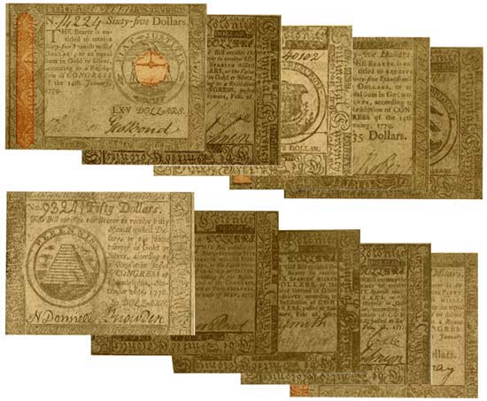
Each side would repay debts owed from before the war.

Slide 11
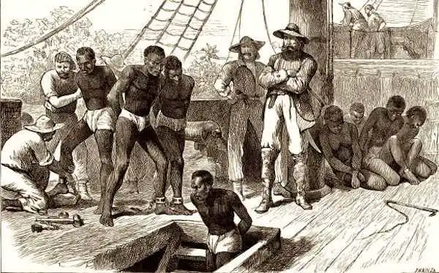
The British would return any slaves they had captured.

Slide 12
Congress would recommend that property taken from the Loyalists by the states be returned.

Slide 13
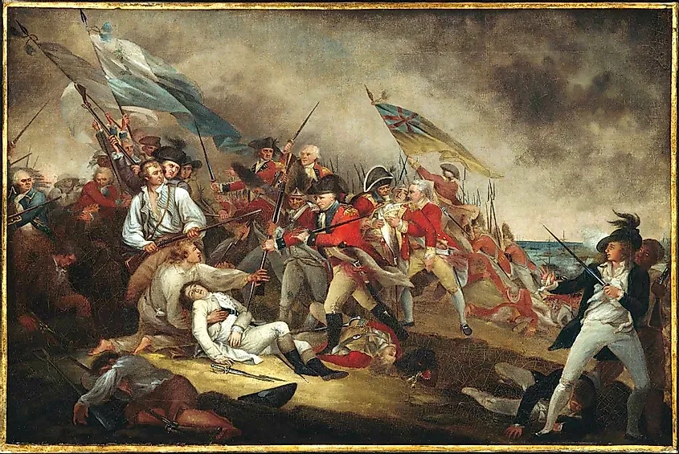
The Revolutionary War was costly in both money and lives. Around 25,000 Patriots died during the Revolutionary War. That is 1% of the population. 6,800 of them were killed in action. The rest died from disease. 6,100 more were wounded.

Slide 14
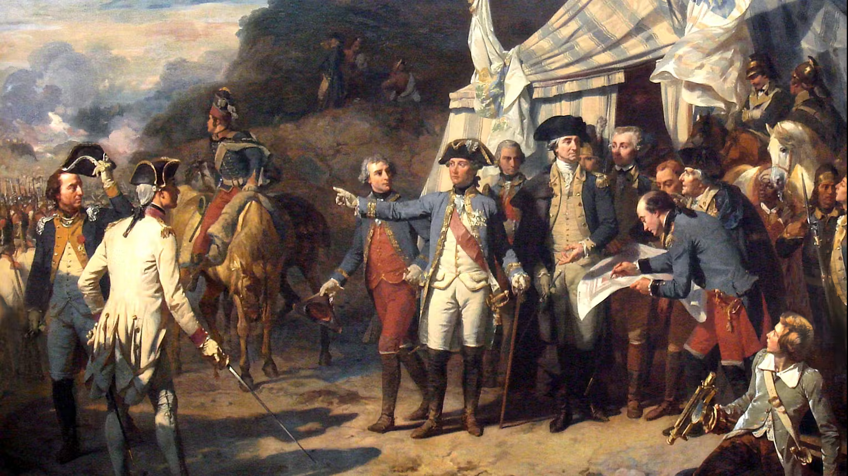
The French, who were allies to the Patriots, lost 2,112 soldiers during the war.

Slide 15
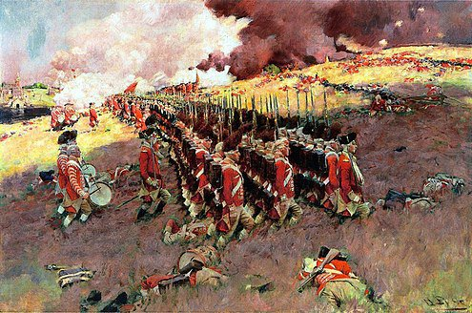
The British had 10,000 soldiers die in the Revolutionary War. Another 7,000 Loyalists, 7,500 Hessians, and 500 Native Americans also died.

Slide 16
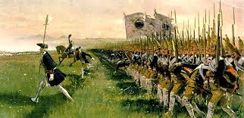
After the war, it is estimated that over 5,500 Hessians deserted the army and settled in the United States.

Slide 17
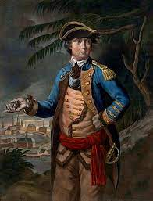
On the other hand, an estimated 80,000-100,000 Loyalists left the United States during and immediately after the war. This included thousands of Native Americans and African Americans.

Slide 18
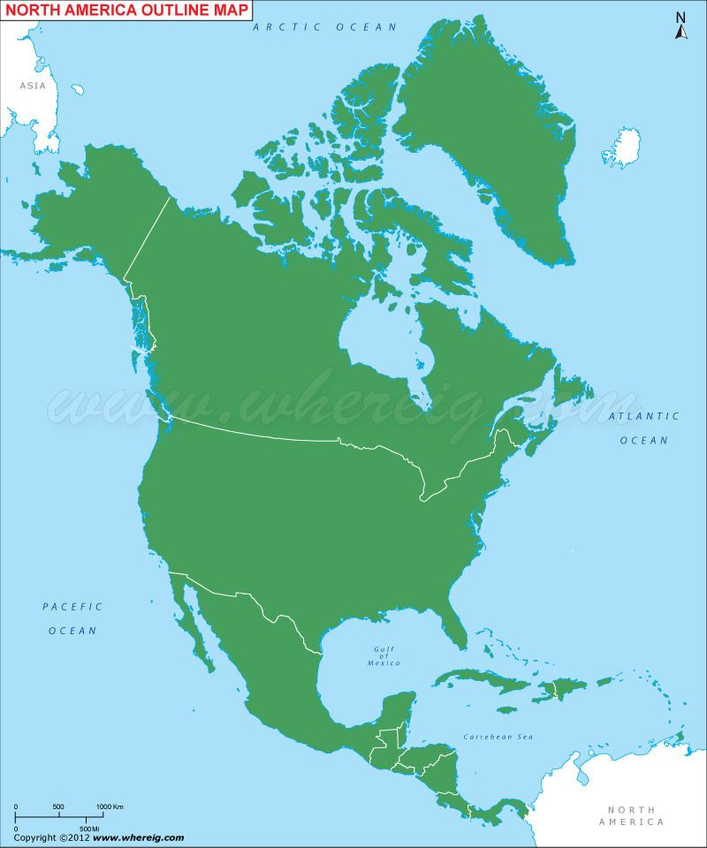
Most Loyalists went to other parts of North America controlled by Britain like Canada and the Caribbean Islands. This greatly changed the culture of Canada from having a mainly French tradition and language to a mix of French and now English.

Slide 19
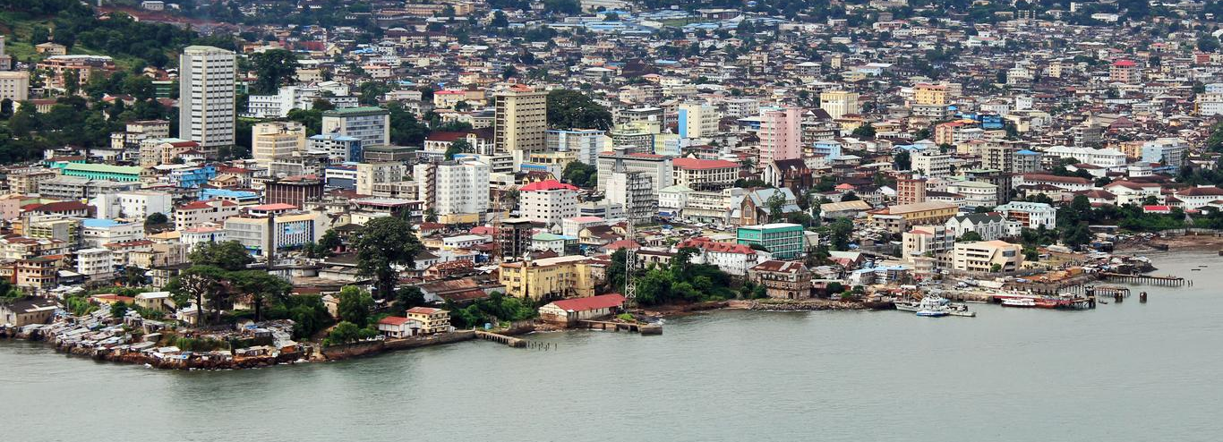
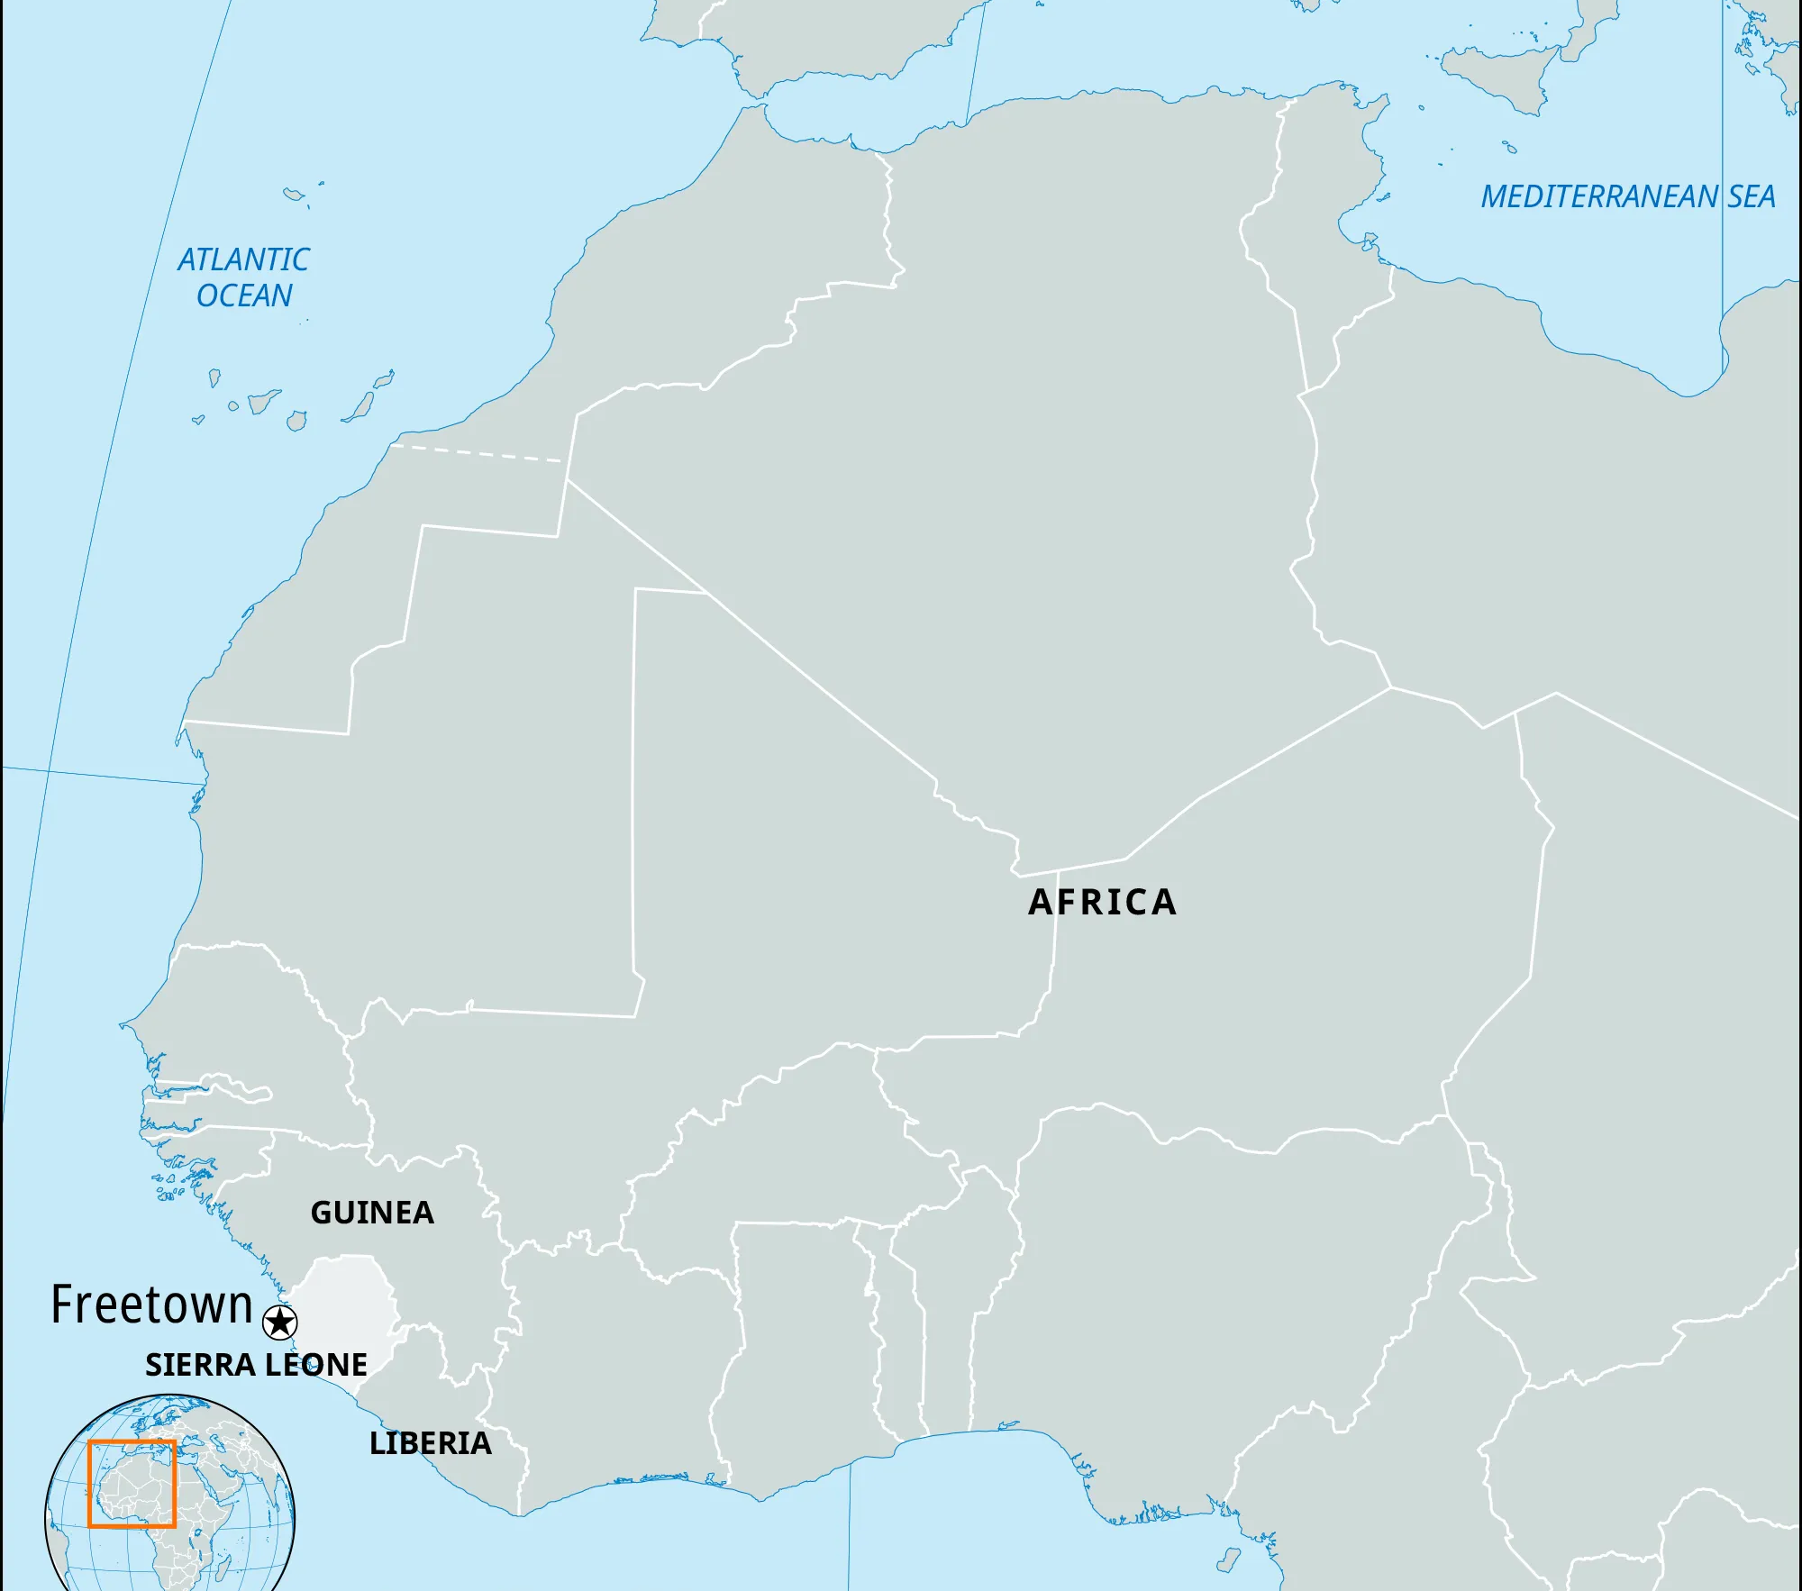
In 1792, around 1,000 black Loyalists left Canada and went to Sierra Leone in Africa. They founded Freetown which is now the capital of that country.

Slide 20
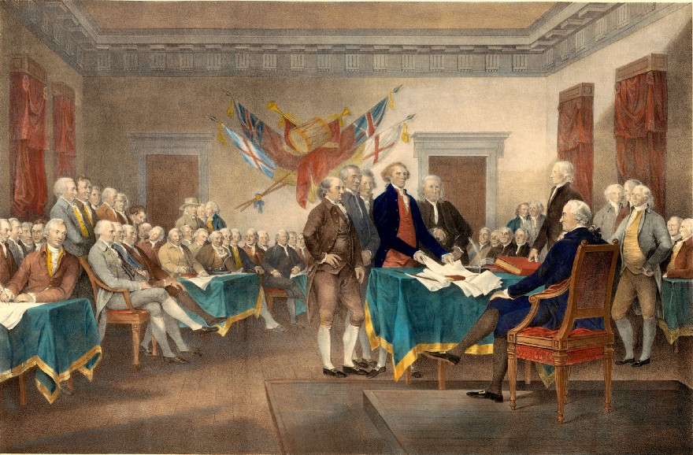
As soon as America declared its independence from Great Britain, the leaders of the Continental Congress new they needed to establish new governments.

Slide 21
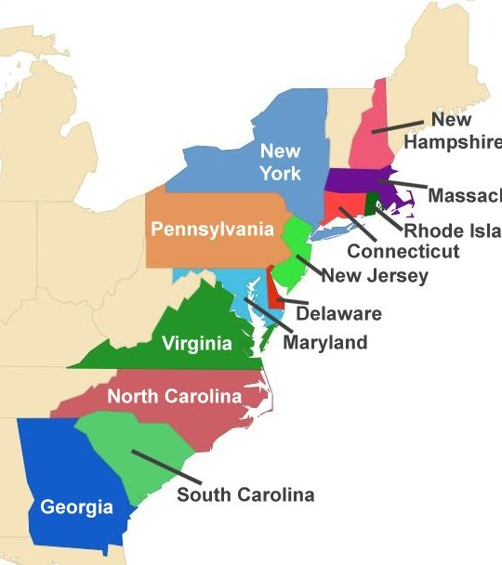
Each colony, now being a state, had to write laws to govern themselves. Between 1776 and 1780, each state formed a new government. Eleven of the states wrote new constitutions, while Connecticut and Rhode Island reworded their colonial charters.

Slide 22
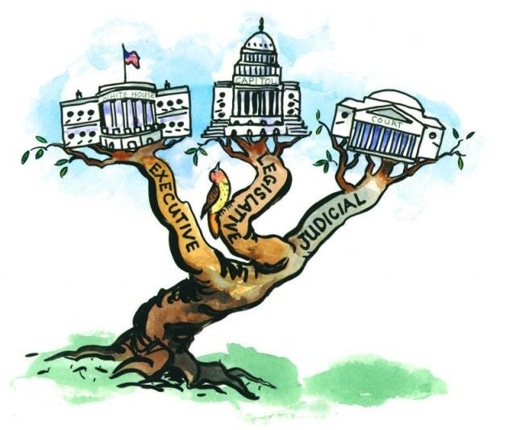
In all thirteen states, the power of the government was divided between three branches, or groups.

Slide 23
The legislative branch makes laws.

Slide 24
The executive branch enforces laws.

Slide 25
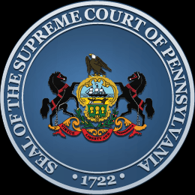
The judicial branch interprets laws and punishes people who break the laws.

Slide 26
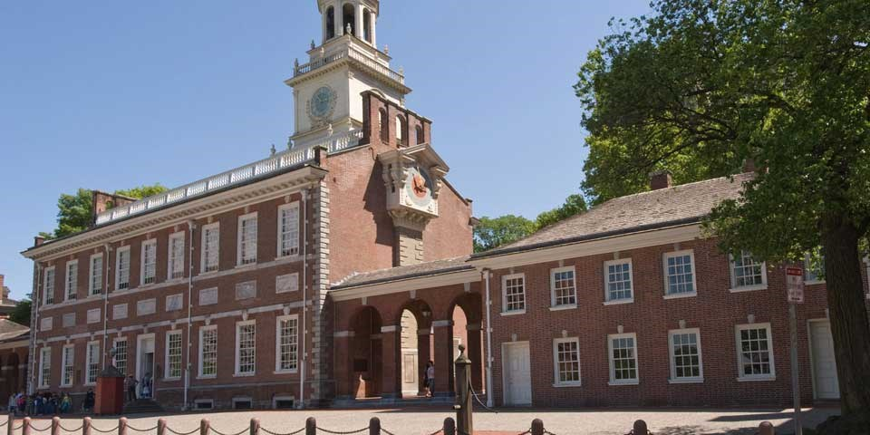
As each of the states were forming their own governments, the Continental Congress knew they needed to form a government for the nation as a whole.

Slide 27
They agreed that the government of the new United States should be a republic. In a republic, the citizens choose representatives to manage the government.

Slide 28
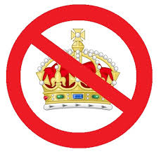
Fearing a central government would become too powerful, they formed a confederation of states with a weak central government.

Slide 29
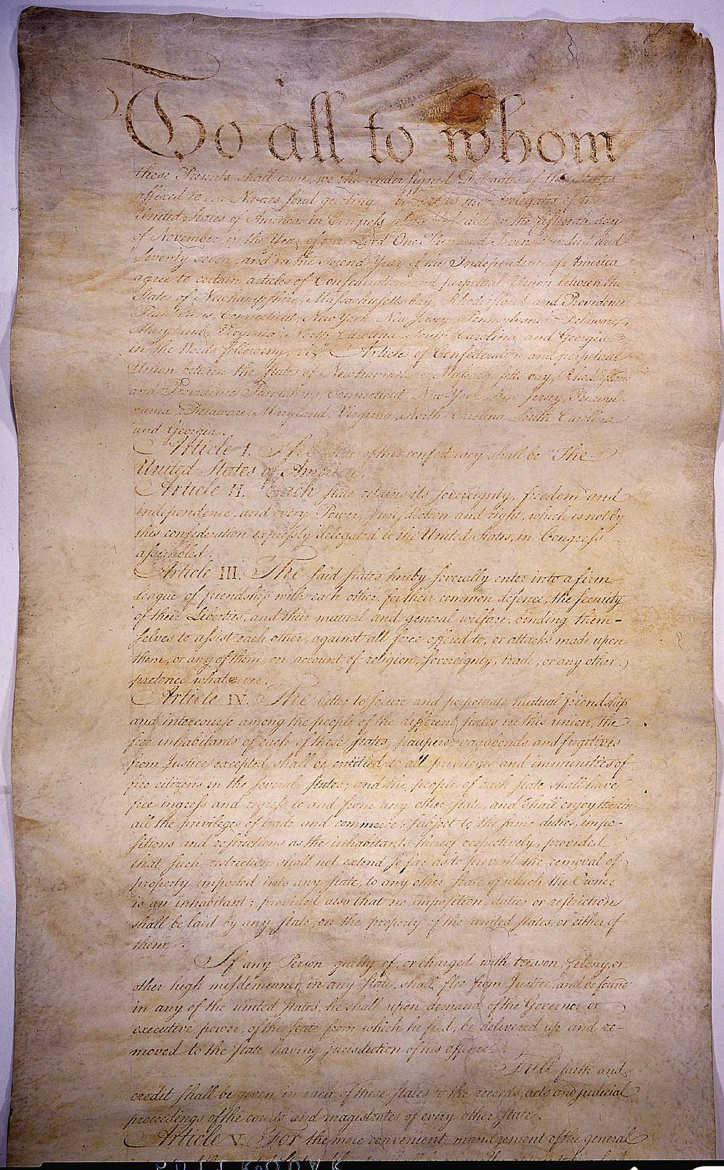
The plan for this government was called the Articles of Confederation. Under the Articles, the United States would have a national government, but the state governments would be more powerful.

Slide 30
This would prove to be a problem…

